Slide 1
Evolution of Text Representation

Slide 2
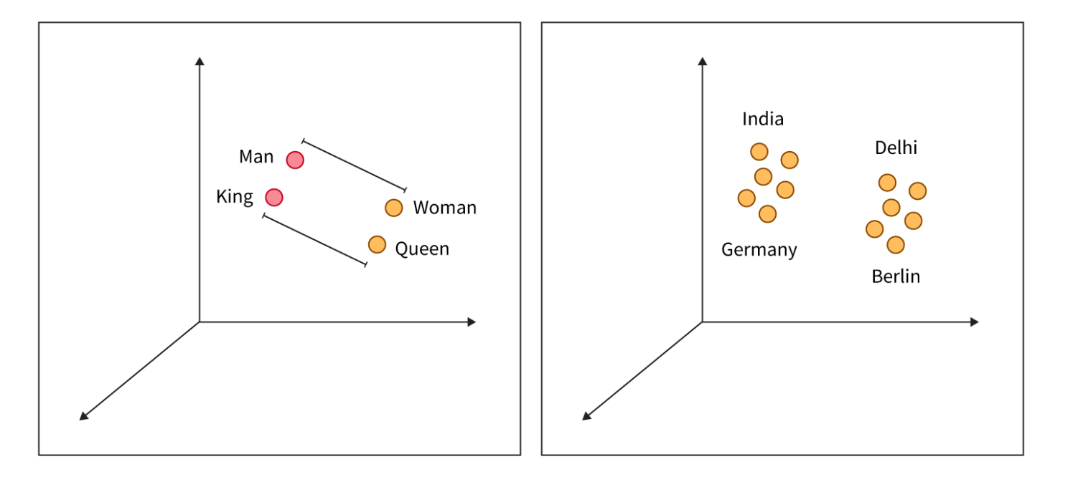
Text representation
Why does text representation matter?
Computers process numbers, not words.
Text must be converted into a numerical format.
Effective representations improve NLP tasks (translation, search, sentiment analysis).

Slide 3
Text representation
What is Text Representation?
Definition: The process of converting human language into a machine-readable format.
Goals:
Preserve word meaning and relationships.
Enable efficient computation for NLP tasks.

Slide 4
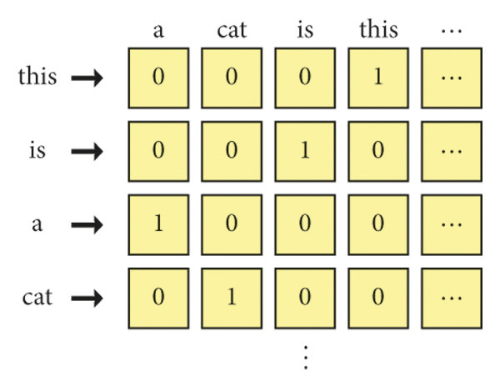
Text representation
One-Hot Encoding
Each word represented as a binary vector.
Example: “cat” → [0,1,0,0]
Limitations:
• Sparse, high-dimensional.
• No meaning or relationship between words.

Slide 5
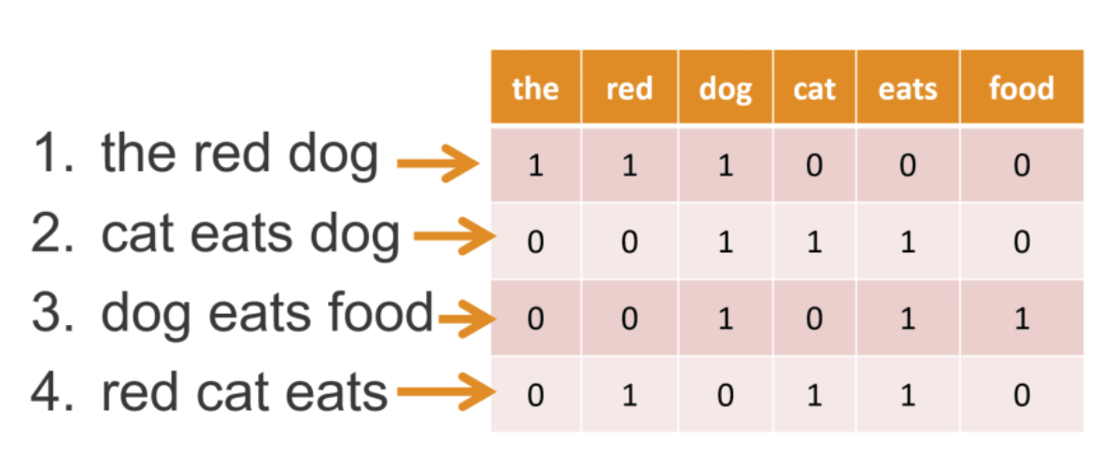
Text representation
Bag-of-Words (BoW):
• Counts word occurrences in a document.
• Ignores order and context.
• Limitations:
• Still lacks word relationships.
• High-dimensional for large vocabularies.

Slide 6
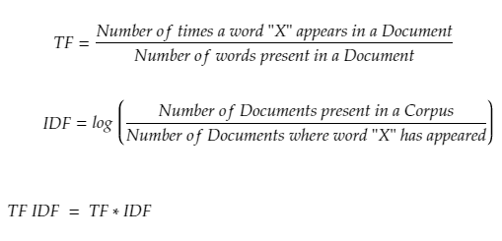
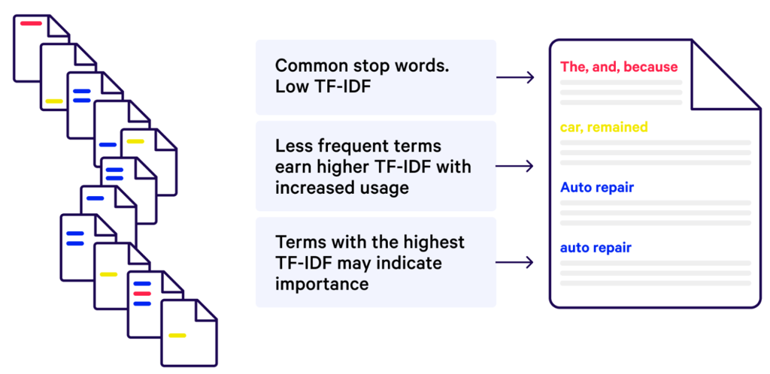
Text representation
TF-IDF (Term Frequency-Inverse Document Frequency):
• Weights words by importance in a corpus.
• Helps with filtering common words (e.g., “the”, “is”).
• Limitations:
• Still lacks word relationships.
• High-dimensional for large vocabularies.

Slide 7
Text representation
TF-IDF (Term Frequency-Inverse Document Frequency):
• Weights words by importance in a corpus.
• Helps with filtering common words (e.g., “the”, “is”).
• Limitations:
• Still lacks word relationships.
• High-dimensional for large vocabularies.

Slide 8
Text representation
TF-IDF (Term Frequency-Inverse Document Frequency):
• Weights words by importance in a corpus.
• Helps with filtering common words (e.g., “the”, “is”).
• Limitations:
• Still lacks word relationships.
• High-dimensional for large vocabularies.

Slide 9
Text representation
The Shift to Dense Representations – Word Embeddings
Why move beyond BoW?
• Need for semantic meaning in representations.
Introduction to Word Embeddings:
• Words represented as dense vectors in a continuous space.
• Similar words have similar vector representations.
• Enables capturing meaning, synonyms, and analogies.

Slide 10
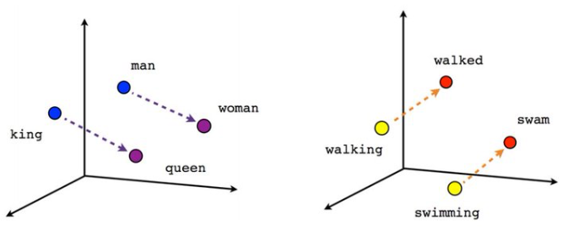
Text representation
Word2Vec
• Learns word meanings based on context.
Two architectures:
• Skip-gram: Predicts surrounding words.
• CBOW (Continuous Bag-of-Words): Predicts center word from context.
Example: “King - Man + Woman ≈ Queen”

Slide 11
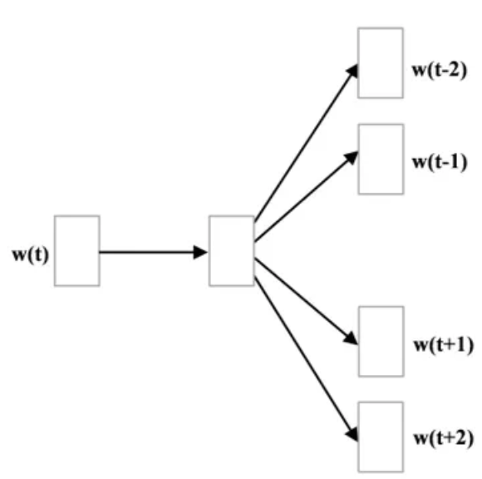
Text representation
Word2Vec - Skip-gram
• The Skip-gram model predicts context words given a target word.
Process:
1. Input: A single word (target word).
2. Output: Likely words appearing in its context (surrounding words).
3. Training: Uses a neural network to learn embeddings where words with similar meanings have similar vectors.
Example:
• Sentence: “The cat sits on the mat.”
• Training pairs generated:
• (cat → sits), (cat → the), (cat → on), etc.

Slide 12
Text representation
Word2Vec - Skip-gram
• The Skip-gram model predicts context words given a target word.
Process:
1. Input: A single word (target word).
2. Output: Likely words appearing in its context (surrounding words).
3. Training: Uses a neural network to learn embeddings where words with similar meanings have similar vectors.
Example:
• Sentence: “The cat sits on the mat.”
• Training pairs generated:
• (cat → sits), (cat → the), (cat → on), etc.

Slide 13
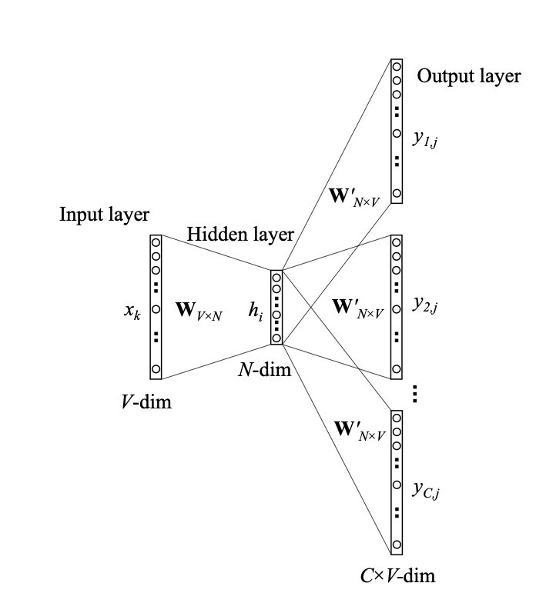
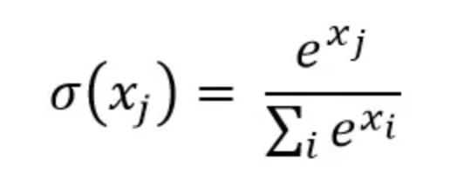
Text representation
Word2Vec - Skip-gram
Step 1. Define corpus: “This is a cat” Step 2. Compute One-hot encoding
Step 3. Define a window size (e.g. 1) Step 4. Create training data as: ((this, is), (is, this), (is, a), (cat, a) etc. Step 5. Feed in the word encodings as pairs of input (x) – output (y)
Step 6. h weights become the embeddings a given word x
[Paper]
Softmax

Slide 14
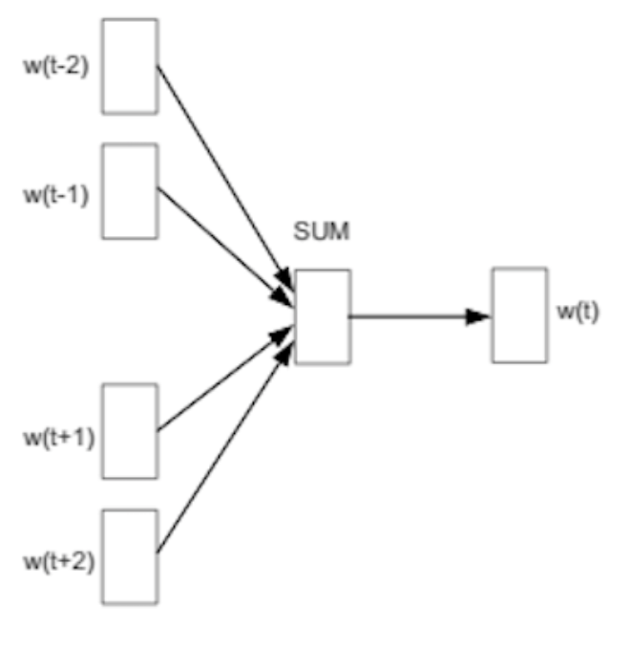
Text representation
Word2Vec - CBOW
• CBOW predicts the target word given a set of surrounding words.
• Works well for common words since it generalizes across contexts.
Process:
1. Input: Multiple context words.
2. Output: Predicts the most probable missing word (target word).
3. Training: Uses a neural network to learn the probability of a target word appearing in a given context.
Example:
• Sentence: “The cat sits on the mat.”
• Context words: [The, sits, on, the]
• Target word: cat
• More efficient for training than Skip-gram (better for frequent words).

Slide 15
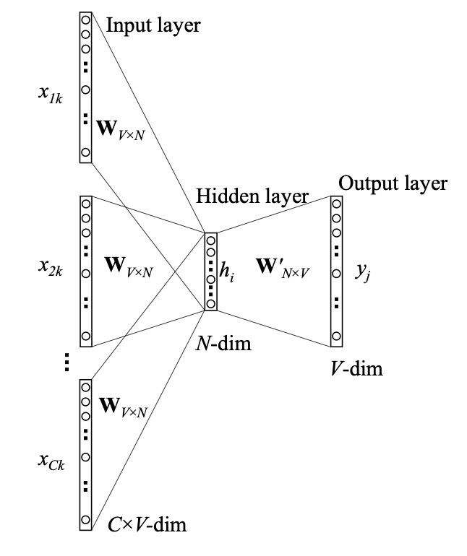
Text representation
Word2Vec - CBOW
Step 1. Define corpus: “This is a cat” Step 2. Compute One-hot encoding
Step 3. Define a window size (e.g. 1) Step 4. Create training data as: ((this, a), is), ((a, beautiful), cat) etc. Step 5. Map the input words to embeddings and
take their average vector.
Step 6. Screenshot 2025-03-04 at 09.58.30
Softmax
[Paper]

Slide 16
Text representation
Word2Vec – CBOW vs Skip-Gram
Feature | CBOW | Skip-Gram
How it works | Predicts target word | Predicts context words from a single target word
Training pairs | (Context words → Target word) | (Target word → Context words)
Computation efficiency | Faster (averages context embeddings) | Slower (trains on more word-context pairs)
Performance on Rare words | Weaker (relies on frequent word patterns) | Better (learns well from limited data)
Best for | Large datasets with frequent words | Small datasets, sparse word occurrences
Memory usage | Lower (less data needed) | Higher (more training pairs needed)
[Paper]

Slide 17
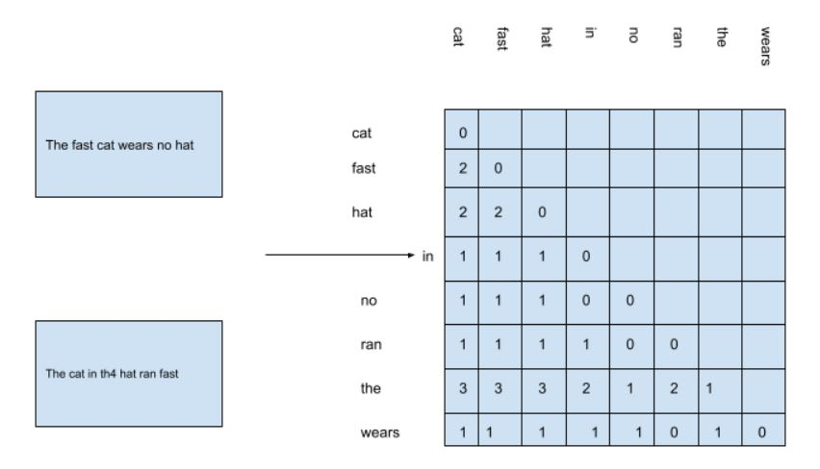
Text representation
GloVe (Global and Vectors)
• Uses word co-occurrence matrix (X), where for each word (X_i) we represent how often the word appears in the context of word all the other words (X_j).
• Captures global context, not just local context like Word2Vec.
Advantages over Word2Vec:
• Better at handling rare words.
• Preserves meaning across different domains.

Slide 18

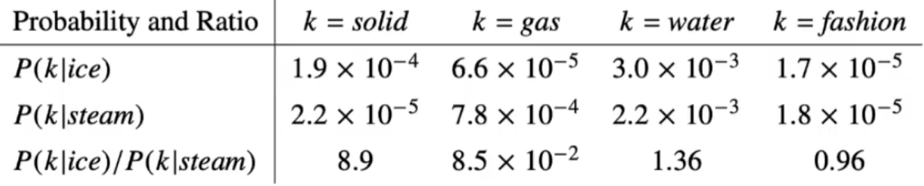
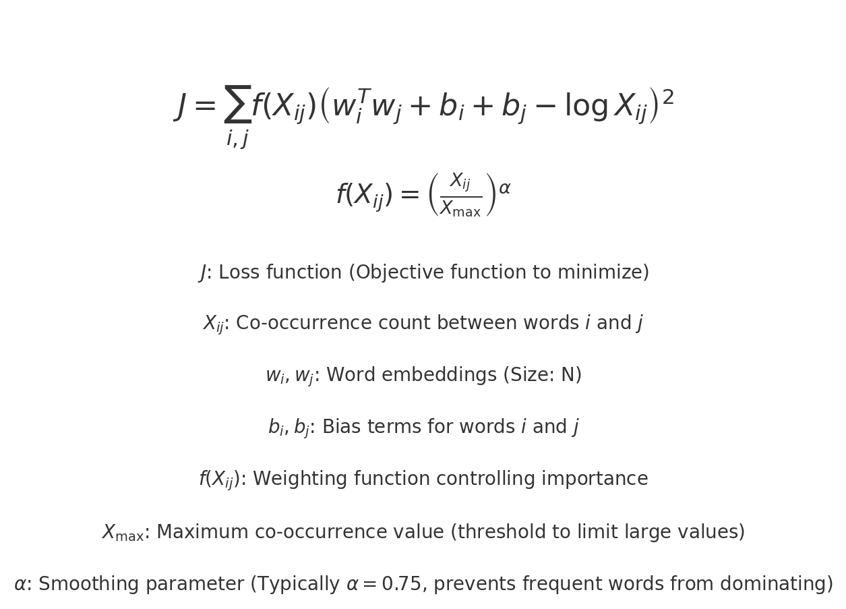
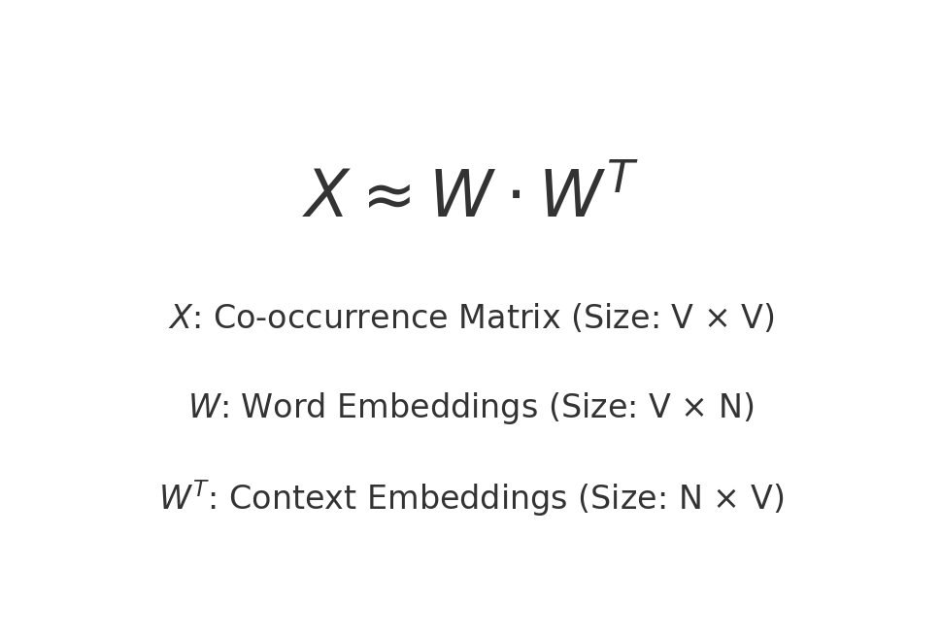
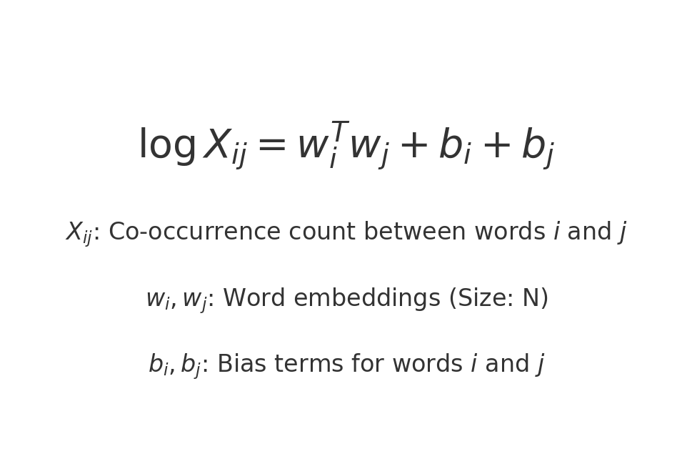
Text representation
GloVe (Global and Vectors)
ice
steam
neither
Weighted least squares regression
Matrix factorization
Optimized function
[Paper]

Slide 19
Text representation
FastText
• Uses Skip-gram / CBOW architectures, but instead of learning embeddings for whole words, it breaks words into smaller subword units (n-grams).
• These n-grams are used to generate word embeddings, rather than treating the word as a single entity.
• Example (word: “apple”, n=3):
[”<ap”, “app”, “ppl”, “ple”, “le>”] (special boundary markers < > included).
• The final word vector is the sum of its n-gram vectors.
[Paper]

Slide 20
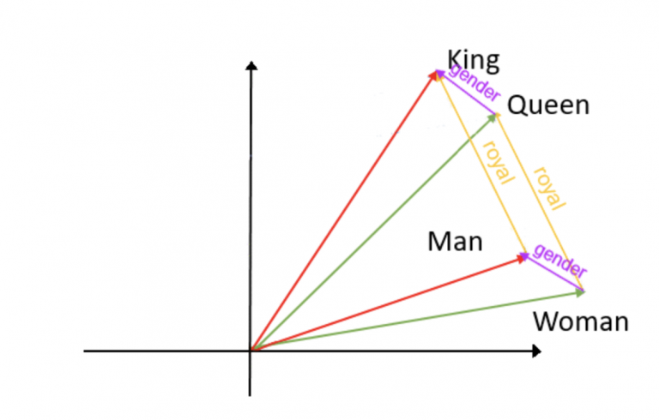
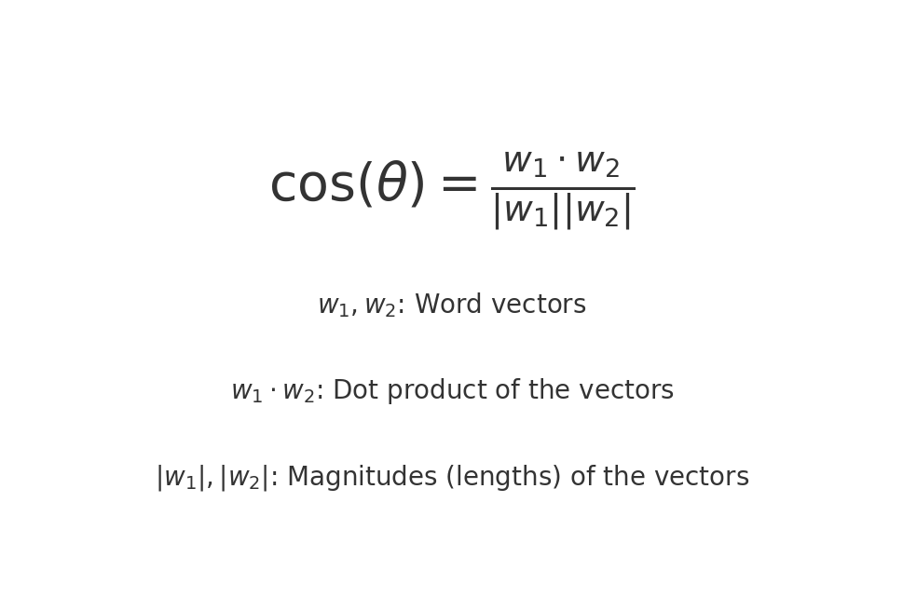
Text representation
How to use text representation?
Once words are in vector form, we can apply mathematical operations:
• Distance Metrics: Measure similarity between words.
• Linear Algebra: Enable word analogy tasks.
Examples:
• “Paris - France + Germany ≈ Berlin” • “King - Man + Woman ≈ Queen”

Slide 21
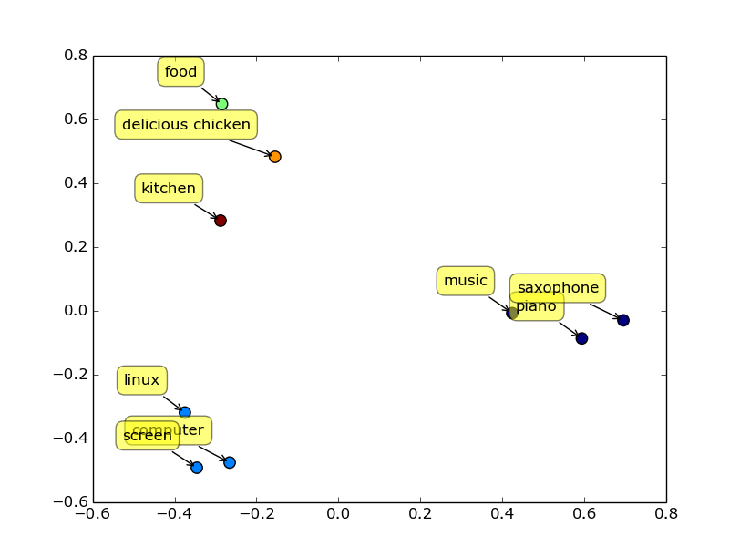

Text representation
Dimensionality Reduction
Principal Component Analysis (PCA) reduces the number of features while keeping most of the dataset’s variance.
Why? Help preserving embeddings meaning, by allowing to visualize the data.

Slide 22
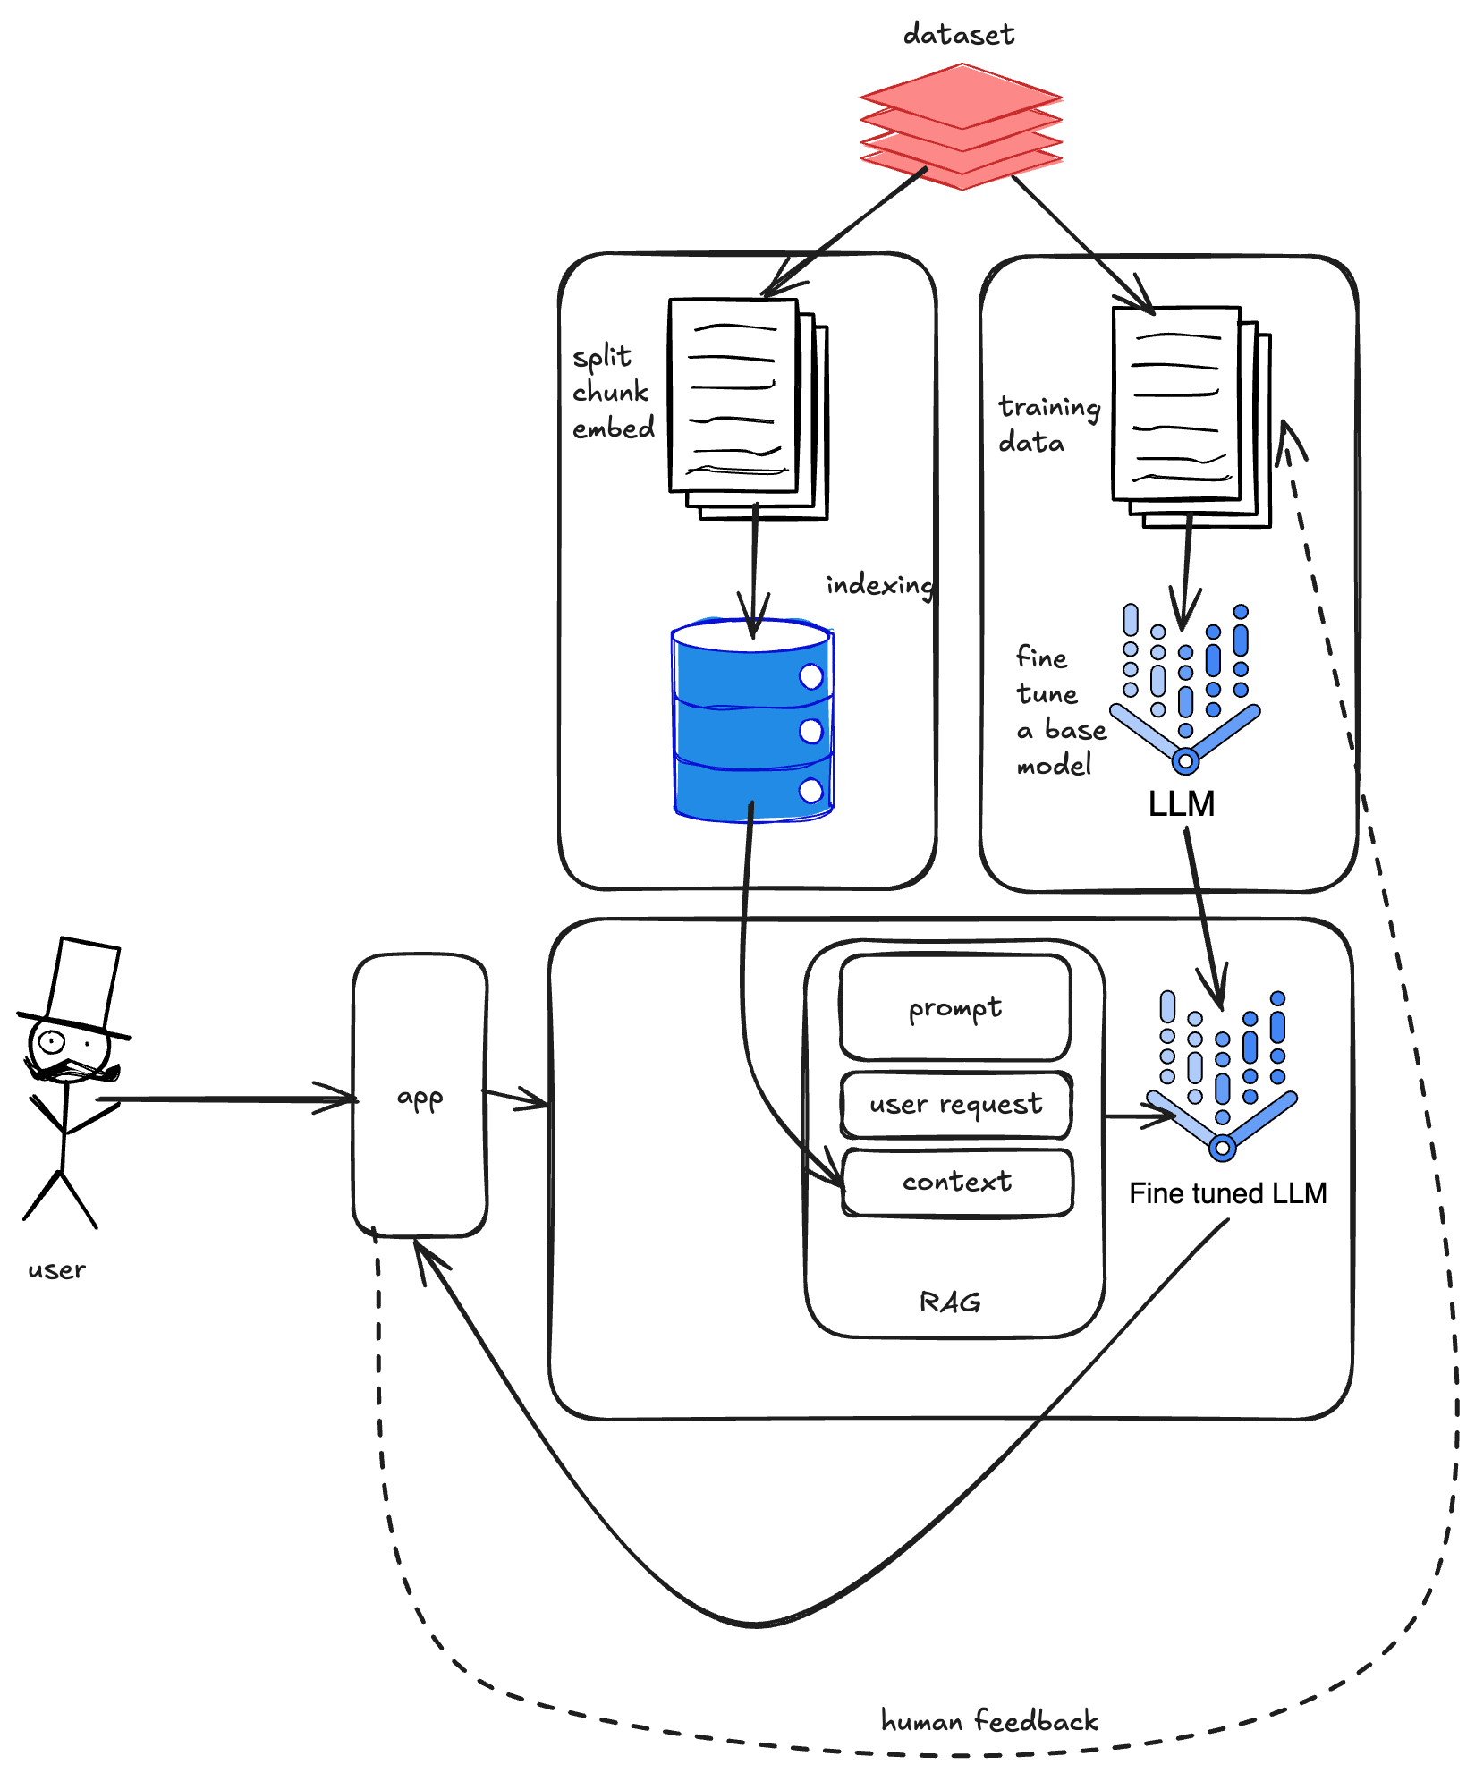
Project
• Team Composition: 5 students per team.
• Roles: Teams decide roles based on skills and responsibilities.
• Deadline for Team Formation: End of Week 2.
• Goal: Develop an LLM-based application capable of reasoning over a custom dataset.
The solution should:
• Support data ingestion of new datasets.
• Allow task-specific fine-tuning (Q&A, etc.).
• Implement RAG.
• Incorporate RLHF.
• Handle toxicity/hallucinations.

Slide 23
Project
Evaluation:
Completeness – Includes data embedding, fine-tuning (if needed), RAG techniques.
Originality – Innovative approaches to problem-solving.
Technical Depth – Architectural and implementation choices.
Week Deliverable
Week 2 Team formation finalized.
Week 4 Submit RFC: Overview, Motivation, Goals (1-page document in Microsoft Teams).
Week 5-6 Architecture Presentation: Dataset selection, chunking strategy, vector database choice, model choices, RAG strategies to try. Includes timeline proposal for 5-6 up to 11-12. (labs))
Week 8-9 Progress Check: Teams present updates based on timeline (labs)
Weeks 11-12 Final Project Presentations (15 min demo + documentation + source code).
Each delay results in a penalty of 2 points.

